Slide 1

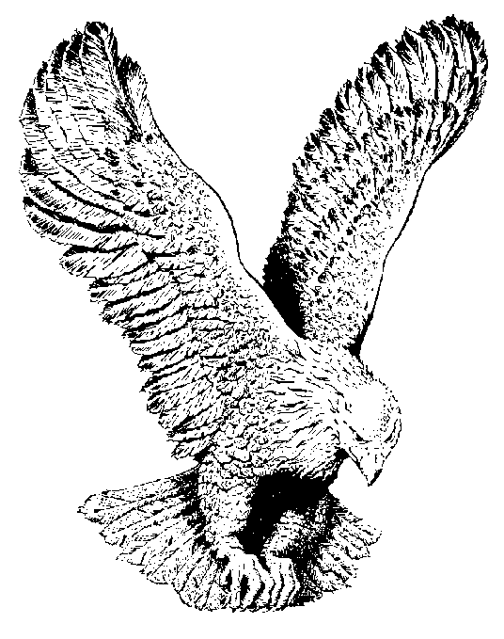
IMELA IMELA OKAKA
Imela, Imela
Okaka, Onyekeruwa (Great and Might creator of the world)
Imela, Imela (Thank You! Thank You!)
Eze mo (My King)

Slide 2
Onyedikagi (Who is like You?)
Ekene diri gi (All Glory belongs to You)
Onye ne mema (He who does good)
Onyedikagi (Who is like You?)
Ekene diri gi (All Glory belongs to You)
Onye nagworia (Mighty Healer)

